Slide 1

Project Title E-Commerce Application
Major Project - II
CS- 805
Problem Statement:
The objective of this project .i.e. E- Commerce Application is to provide an intuitive and scalable eCommerce solution that meets the needs of both users and admins while providing an easy-to-use interface, reliable payment processing, and efficient order management. Integrated with AI-powered Virtual Assistants to answer queries and assist with product recommendations.
Project Group Number: 42
Group Member Details: Swaleha Khan 0187CS211172
Vased Ali 0187CS211179
Zubair Alam 0187CS211190
Mo Akbar 0187ME211030
Guide Details:
Prof. Mayank Kurchaniya

Slide 2
Idea/Approach Details
Abstract:
A Full Stack eCommerce platform allowing users to explore products, make purchases with online or COD options, and an Admin Dashboard for managing products.
Idea Solution/Prototype:
It is a Full Stack E-Commerce project, an online shopping platform that allows users to explore products, make purchases, and choose from various payment options, including both online and Cash on Delivery (COD).
In this responsive user interface, customers can browse, filter, and select product variants like size before adding items to their cart. Checkout process online payment gateways or choose COD.
It also includes an Admin Dashboard that enables store administrators to efficiently manage the product catalog by adding, updating, and removing products.
Technology stack:
Software
Front-end - React.js
Back-end API – Node.js and Express
Database - MongoDB
Payment Integration - Stripe and Razorpay
Deployment – Vercel
Virtual assistants - Natural Language Processing (NLP) and machine learning using Dialogflow and Socket.io.

Slide 3
Project Requirements
Functional Requirements
Non Functional Requirements
User Registration/Login- Users can register or login.
Select Product- Browse, filter based on variants.
Purchase Product- Add desired products to cart.
Make Payment- Pay either through online or COD.
Admin Panel-Admins dashboard to login, manage products and order management.
Responsive and user friendly interface.
Secure payment gateway integration.
Scalable architecture for growing users.
Data encryption and security.
Multi-device support (desktop, mobile).

Slide 4
Project Requirements
Hardware and Software requirements
(Developer)
Hardware and Software requirements
(Client)
Software
Front-End
HTML, CSS, JavaScript
React.js
Back-End
Node.js for development
Express.js for API
Database
MongoDB for NoSQL database
Payment Gateway SDKs/APIs
Stripe and Razorpay
Virtual Assistant
Dialogflow and Socket.io
Software-
Operating System
Browser
Payment Platforms
Hardware-
Internet
Processor

Slide 5
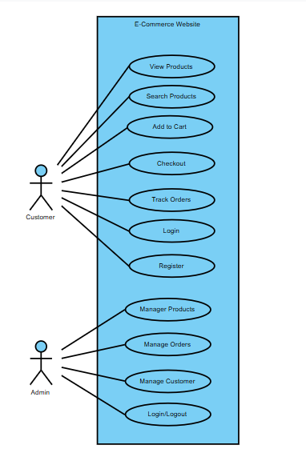
Design
Use Case Diagram

Slide 6
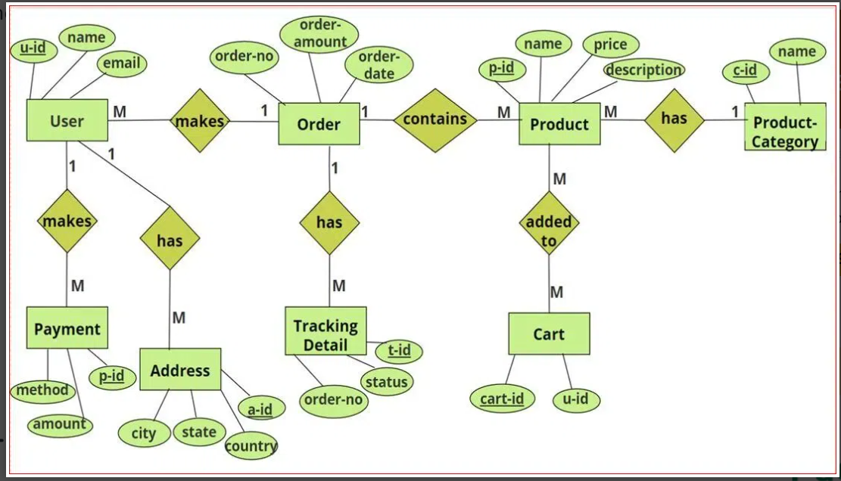
Design
Entity-Relationship Diagram

Slide 7
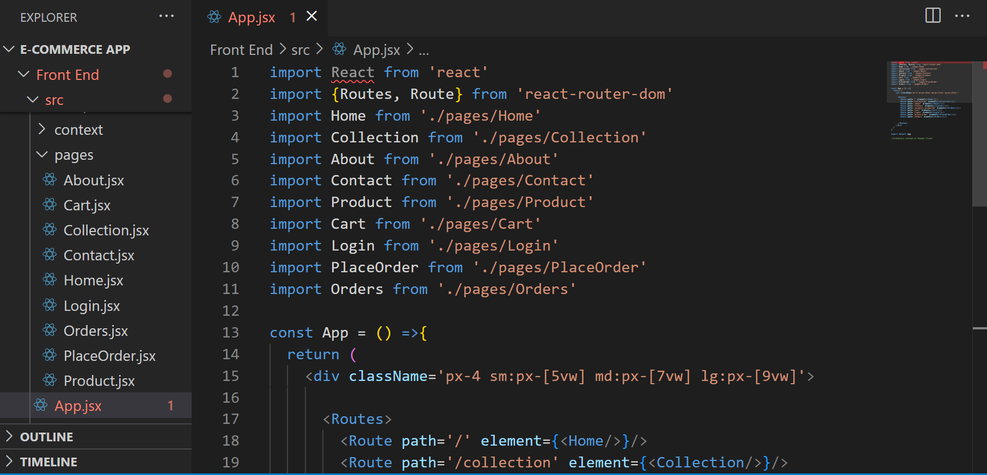
Project Screen shorts

Slide 8
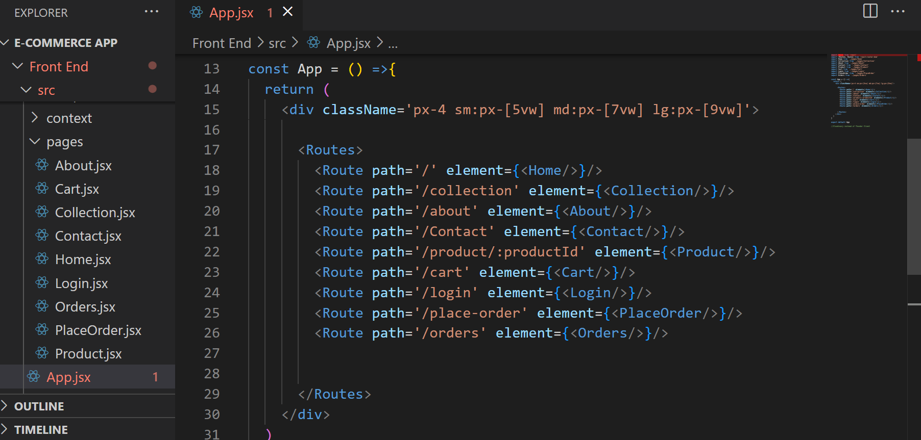
Project Screen shorts

Slide 9
Limitations
Limitations of this project are as follows:
Users can only make payment through COD method.
Payment process needs more features like map integration of the stores.

Slide 10
Conclusion
Conclusion of this project are as follows:
We are able to browse, filter and select products based on their interests and variants available.
They are able to purchase products using COD method of payment and track their progress.
They can login/logout whenever they want.
Admin is able to add, update, delete products and manage orders.
Admin is also required to sign in.

Slide 11


